Slide 1

Department of Information Technology
NBA Accredited A.P. Shah Institute of Technology G.B.Road, Kasarvadavli, Thane(W), Mumbai-400615 UNIVERSITY OF MUMBAI Academic Year 2021-2022

Slide 2
A Project Report on A 3D Storyline Using Unity Game Engine Submitted in partial fulfilment of the degree of Bachelor of Engineering(Sem-8) in INFORMATION TECHNOLOGY By Aaryan Parab 18104060 Nikhil Rathod 18104001 Tanaya Patil 18104022 Under the Guidance of Prof. Neha Deshmukh

Slide 3
1.Project Conception and Initiation

Slide 4
1.1 Abstract
Within the modern technological era, there is a growing desire for video games with compelling narratives and storylines. The popularity of e-sports has grown, and many players have found success in streaming and tournaments.With an upsurge in expansive user base, the gaming industry is taking off in wonderfulness, drawing in major innovation powerhouses to compete within the commercial center. This paper discusses a single-player game with an Indian folklore story. The purpose of this paper is to pique children's and teenagers' interest in Indian culture by portraying it as a video game. According to the study, video games are played or have been played by more than a 90\% of children. It has the potential as being a very extremely powerful method of disseminating information if applied effectively. This enables us to develop a Mahabharata-themed video game that will pique gamers' interest in the epic story.

Slide 5
1.2 Objectives
To build a video game with exciting game scenes using Unity 3D involving the Indian culture.
To involve youngsters in Indian culture in an entertaining way.
To build 3 dimensional visual world with high graphics.
To achieve perfect efficiency in creating 3D modelling using blender
To create ,edit and restoring audio using audition tool.

Slide 6
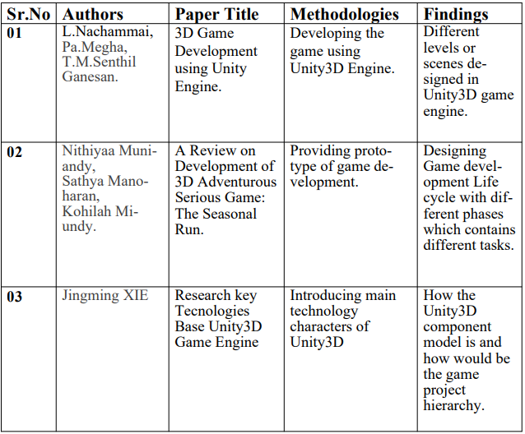
1.3 Literature Review

Slide 7
1.4 Problem Definition
Indian culture has played an important role in molding our lives. Indian culture is one of the most ancient cultures of the world. The puranas deal with the stories that are old and do not appear in the epics. They contain legends and stories about the origins of world, and the lives and adventures of a wide variety of gods, goddesses and mythological creatures like Asuras, rakshasas, etc. They contain traditions related to ancient kings, incarnations of God. Nowadays our new generation is steering a course towards Modernization and western culture and we can see lack of interest in Indian Culture and Mythology in our younger generation. Young Indian more obsessed with the latest trends of globalization.
To overcome this problem we have implemented one solution in which high graphics 2.5D game will be made to increase youngsters involvement in Indian culture and Mythology in a interactive as well as fascinating way.

Slide 8
1.5 Scope
This game mainly applied in gaming industries to provide an exciting experience.
This can be applied for making the game entertaining for all age groups and mainly focusing on youngsters.

Slide 9
1.6 Technology stack
Unity3D
Blender/Maya
Photoshop Illustrator
Audition Tool
After Effects Tool

Slide 10
1.7 Benefits for environment & Society
A great source to develop early learning skills for younger children
Enhances memory, brain’s speed, and concentration
Improved multi-tasking skills
Provides a way to develop compassion
A new way to experience stories
Create time and space for deeper thinking about topics

Slide 11
2. Project Design

Slide 12
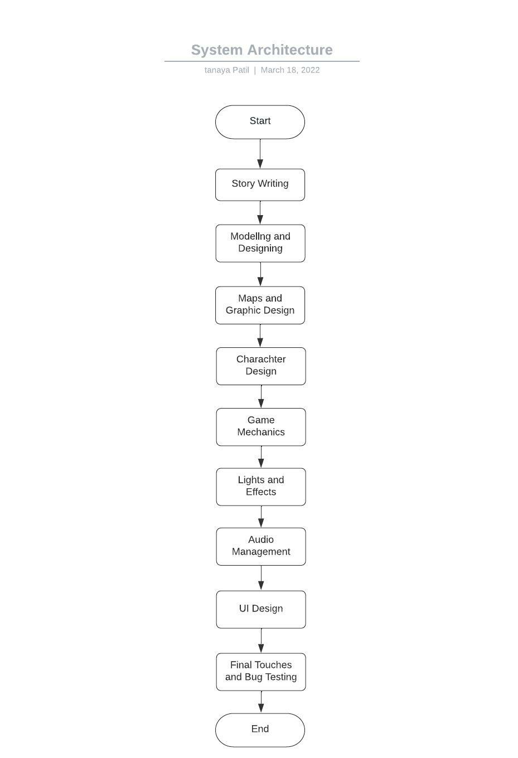
2.1 Proposed System
Fig 1: Proposed System Acrchitecture

Slide 13
2.2 Design(Flow Of Modules)
As a part of the development process, an extensive explanation must be included.It was completely begun with picking a game idea which ought to be appealing game concept and Provide user with a suitable stage where the game can be played. As a another step, a point by point portrayal of all the game components was to be included in a game plan report. Besides, it'll contain data with respect to the game mechanics as well as the software and technology that will be utilized for development. Having decided plan records, the another step was to consider the game structure which incorporates design, environment, surface, and other objects meaning containing UI parts, Animations, Lighting effects and audio management. These are all factors that make a developer have a better understanding of how game works and the way the application feels.

Slide 14
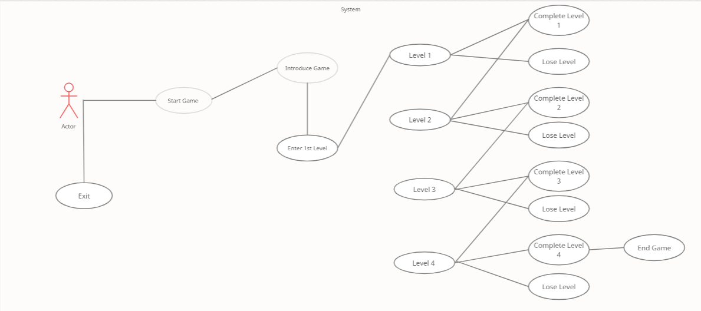
2.3 Description Of Use Case
Fig 2: Use Case Diagram

Slide 15
The above use case diagram representing the graphical representation of a system. This diagram also describing the interactions between the system and its actors. The use cases and actors in use-case diagrams describe what the system does and how the actors use it, but not how the system operates internally. There are a total of 11 use cases that represent the storyline game's specific functionality. A player, or actor, is interacting with a specific use case. A player begins by playing the game. If a player wishes to exit the game, he or she can do so by using the Exit use case. After that, the player can interact with the story information mode and proceed to level 1. If the player wins the game, he or she can advance to the next level; if the player loses, the player must return to level 1. As a result, the player must complete all of the levels, and as soon as he or she completes the fourth level, the game is over.

Slide 16
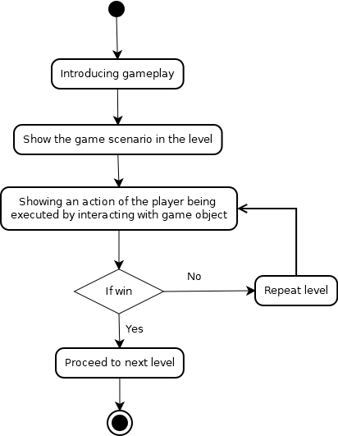
2.4 Activity diagram
Fig 3. Activity Diagram

Slide 17
In above activity diagram, As soon as the player begins playing the game, he or she will be introduced to the game's concept or overview. The player will enter the first level and begin fighting enemies as soon as the introduction is finished. If the player succeeds in completing or winning level 1, he or she will advance to the next level. If a player fails to complete level 1, he or she must restart from the beginning.

Slide 18
3. Implementation

Slide 19
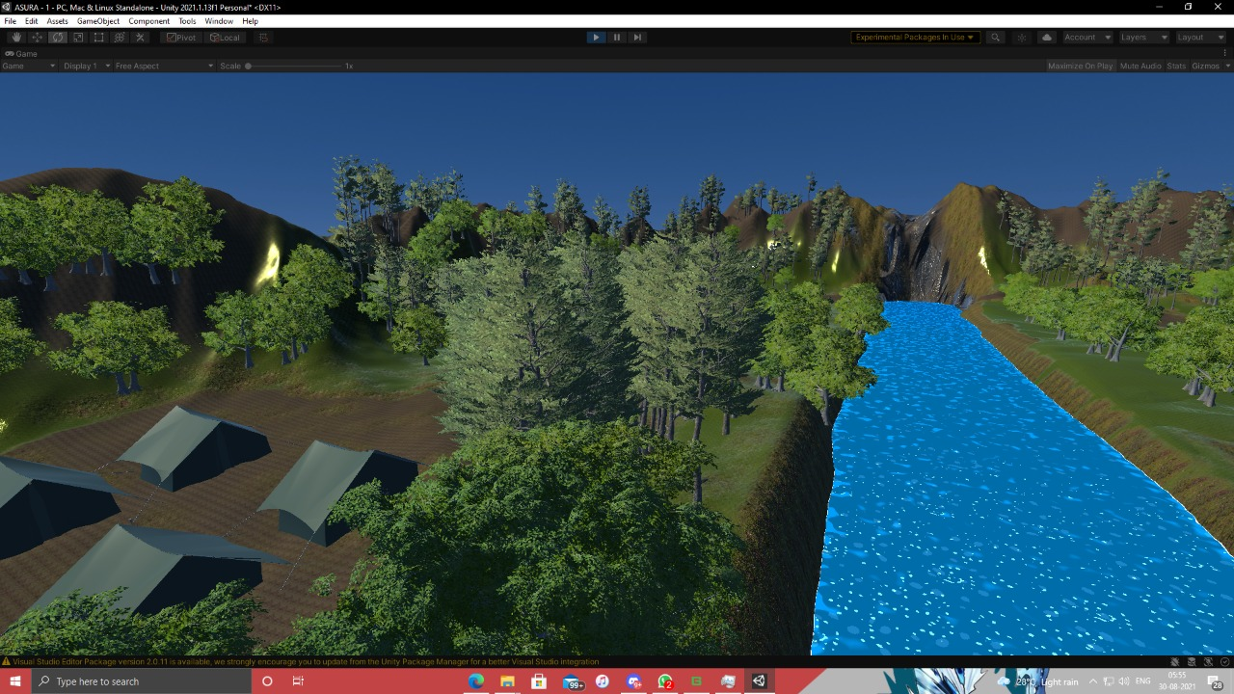
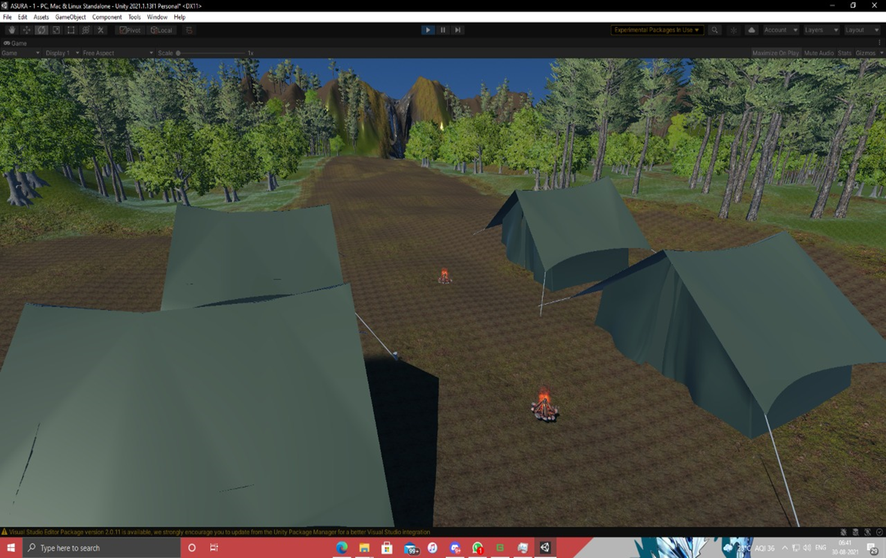
The levels were sketched out using unity3D application.
Fig 4. Level 1
Fig 5. Level 1

Slide 20
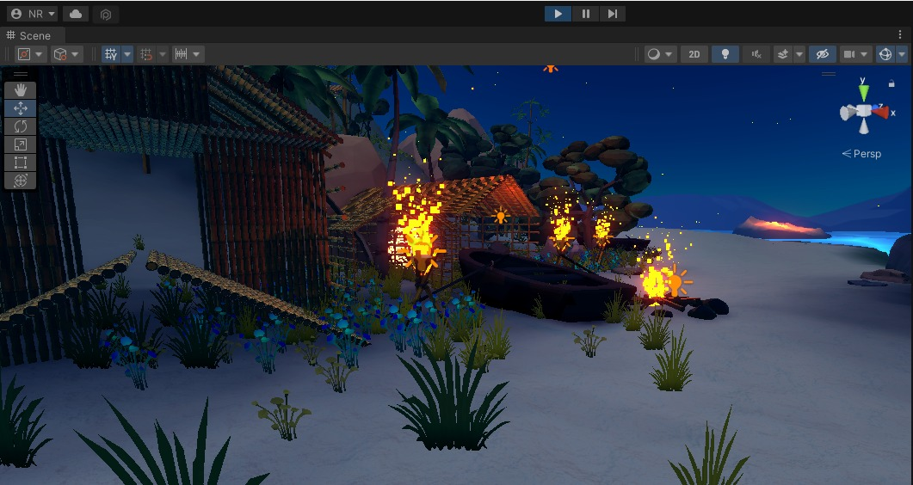
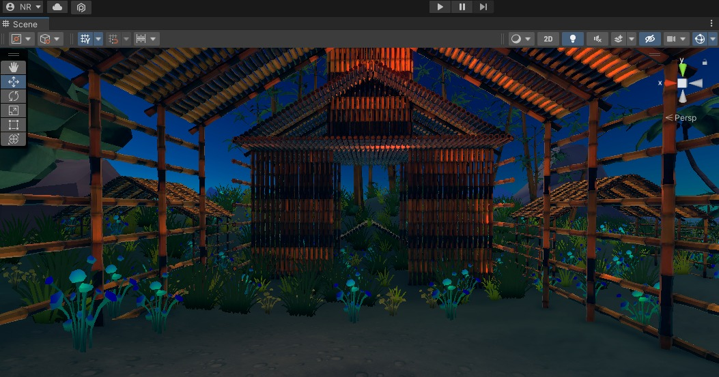
Fig 6. Level 2
Fig 7. Level 3

Slide 21
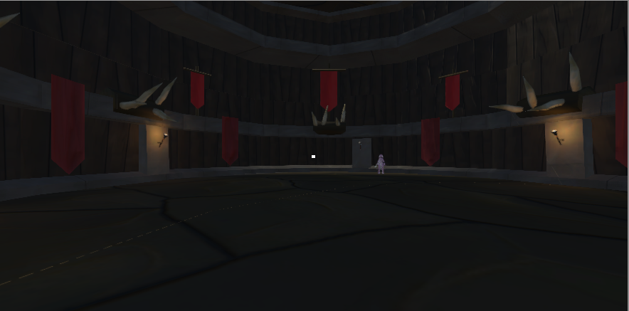
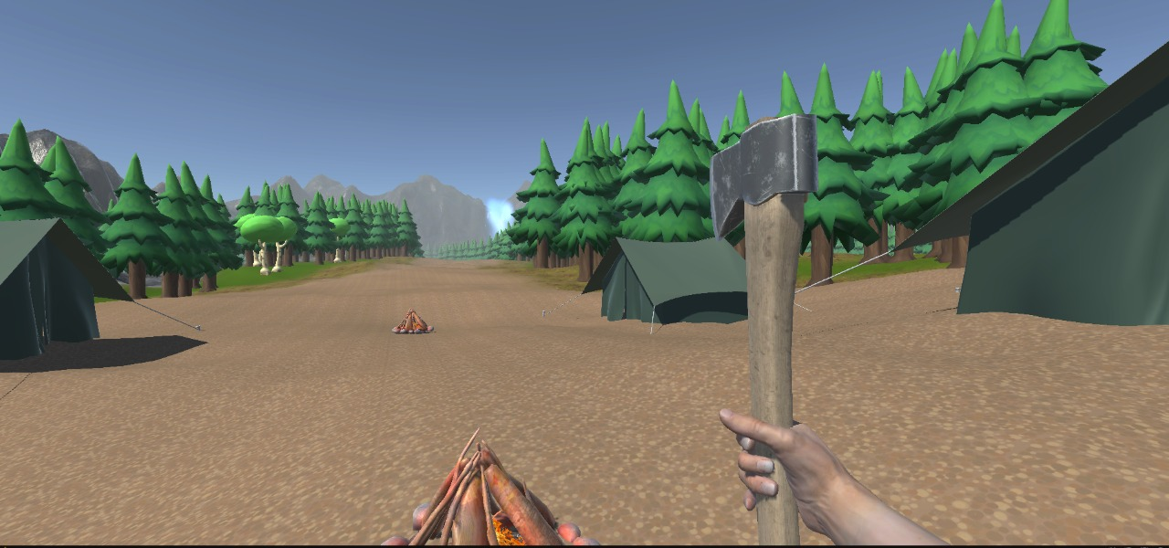
Fig 8. Level 4
Fig 9. FPS View

Slide 22
4. Testing

Slide 23
Functional Testing: 1. Unit Testing: The first level of testing is unit testing, which is frequently carried out by the developers themselves. It is the process of ensuring that individual components of a piece of software are functional and work as intended at the code level. In a test-driven environment, developers will typically write and run the tests before passing the software or feature to the test team. Manual unit testing is possible, but automating the process will shorten delivery cycles and increase test coverage. Debugging will be easier as a result of unit testing because issues will be discovered earlier in the testing process and will take less time to fix than if they were discovered later. For our gaming application, unit testing is the most appropriate software method. We began writing code in the form of units, such as player movement, enemy movement, and attack script, at this point. We also tested each module separately so that we could easily understand each snippet and identify any errors. It aided us in comprehending the desired output of each module that we had divided into separate units.

Slide 24
After each unit has been thoroughly tested, it is combined with other units to form modules or components that perform specific tasks or activities. These are then put through integration testing as a group to ensure that the entire application behaves as expected. User scenarios, such as movement of player or enemy are frequently used to frame these tests. Integrated tests are usually made up of a combination of automated functional and manual tests and can be performed by either developers or independent testers. We had written a code for every single unit that we had divided in unit testing, as we had already mentioned. The next step is to combine them all into a single module. This testing is critical in determining which units will work together without errors. Modules were integrated and tested using sequence diagrams to ensure that they behaved as expected.
2. Integration Testing:

Slide 25
Non Functional Testing: 1. Compatibility Testing:
Compatibility testing determines how well a program or piece of software will perform in various environments. It's used to see if your product works with a variety of operating systems, platforms, and resolution settings. The goal is to ensure that your software's functionality is supported consistently in any environment that your end users are likely to use. The software we're using is Unity Engine. It's free software for creating, designing, and developing 2D and 3D games. We made certain that our gaming application worked on all operating systems. This application runs flawlessly on a variety of operating systems.

Slide 26
5. Result

Slide 27
This project is entirely application-based. As the player propels through the levels they must unravel puzzles/mysteries to develop through the game. The clues to the puzzles/mysteries would be shown through parts of the Mahabharata by transporting the character to the past and reliving some scenes from the Mahabharata. make a developer have a better understanding of how game works and the way the application feels. The foremost objective is to create an engrossing playing environment with high-quality graphics. This is a single-player strategy game that you can play on a computer. The player will progress through several stages. This game has been structured to aid in the progression of the story. The primary focus will be on the story, levels, objects, animation, visuals, scripting, and gaming engine tools. This game will be primarily used in the gaming industry to provide a fun experience. This can be used to make the game more enjoyable for people of all ages, with a focus on children.

Slide 28
6. Conclusion and Future Scope

Slide 29
This project's goal is to create a game architecture that provides a learning outcome while also allowing for emergent interaction between the game and the player. Through the player's active involvement in the medium increases the level of satisfaction he or she derives from it, becoming more involved in the aspects of the game and more willing to participate. Games have significant effects on players based on the time they spend playing them. While excessive gaming can be harmful, moderate gaming can be beneficial, enjoyable, participatory, and, most importantly, educational. As a result, the next generation of instructional gaming will be produced by the same generation that grew up with video games. Individuals who are interested in video games will have a good time as a result of this comprehensive synergy between education and digital gaming. In addition, with our game, we attempted to accomplish nearly everything listed above, so that anyone who played it, whether children or adults, would have interactive entertainment while also learning something about Hindu mythology or culture.

Slide 30
References
A Review on Game Development of 3D Adventurous Serious Game: The Seasonal Game: The Seasonal Run, Nithiya Muniandy, Sathya Manoharan, Kohilah Miundy, Politeknik Metro Kuala Lumour, Malaysia,2020.
3D Game Development using Unity Engine, L.Nachammai, Pa.Megha, T.M.Senthil Ganesan, Velammal College of Engineering and Technology,Madurai, India, 2018.
Research on Key Technologies Base Unity3D Game Engine, Jigming XIE, Information Engineering Institute Guangzhou Panyu Polytechnic College Guangzhou, China. 2012

Slide 31
Paper Publication
Paper entitled “A 3D Storyline Using Unity Game Engine” is presented at “IEEE 2nd CONIT 2022” by Aaryan Parab, Nikhil Rathod and Tanaya Patil.

Slide 32
Thank You

